Slide 1
Information Retrieval
– An Introduction –

Slide 2
What is Information Retrieval ?
The process of actively seeking out information relevant to a topic of interest.
Typically it refers to the automatic (rather than manual) retrieval of documents
Information Retrieval System (IRS)
“Document” is the generic term for an information holder (book, chapter, article, webpage, etc)

Slide 3
IR in practice
Information Retrieval is a research-driven theoretical and experimental discipline
The focus is on different aspects of the information–seeking process, depending on the researcher’s background or interest:
Computer scientist – fast and accurate search engine
Librarian – organization and indexing of information
Cognitive scientist – the process in the searcher’s mind
Philosopher – Is this really relevant ?
…
Progress influenced by advances in Computational Linguistics, Information Visualization, Cognitive Psychology, HCI, …
Notes:
An experimental system attempts to optimize performance for a certain, very specific task (TREC tracks).
An operational system attempts to reach a balance between various functions, and between various functionality and usability.

Slide 4
We will discuss text documents, not other media
Most current tools that search for images, video, or other media rely on text annotations
Real content retrieval of other media (based on shape, color, texture, …) are not mature yet

Slide 5
The stages of IR
Indexed
and structured
information
Creation
Information
Indexing,
organizing
Retrieval
Searching
Browsing
Notes:
The documents are indexed in order to get descriptors that make sense to the system.

Slide 6
The formalized IR process
Real world
Anomalous state of knowledge
Collection of documents
Information need
Document representations
Query
Matching
Results
Notes:
Documents describe events from the real world; they are holders of information.
In order to be stored in a computer system in view of future retrieval, documents need to be processed and abstract document representations derived.
The user has an information need, not always explicit, derived either from an anomalous state of knowledge, or from an assigned task.
Queries need to be formulated in a language compatible to the system.
Following the analysis of the results produced by the matching process, the user’s state of knowledge may change, the information need may be clearer or more refined, or only partially satisfied.
More queries are generated and the results are examined, until the user is happy with the information gathered.

Slide 7
What do we want from an IRS ?
Systemic approach
Goal (for a known information need): Return as many relevant documents as possible and as few non-relevant documents as possible
Cognitive approach
Goal (in an interactive information-seeking environment, with a given IRS):Support the user’s exploration of the problem domain and the task completion.
Notes:
The systemic approach ignored the problems users have formulating or even clarifying an information need.
The cognitive approach considers the searching / matching algorithms ‘perfect’.

Slide 8
The role of an IR system – a modern view –
Support the user in
exploring a problem domain, understanding its terminology, concepts and structure
clarifying, refining and formulating an information need
finding documents that match the info need description
As many relevant docs as possible
As few non-relevant documents as possible

Slide 9
How does it do this ?
User interfaces and visualization tools for
exploring a collection of documents
exploring search results
Query expansion based on
Thesauri
Lexical/statistic analysis of text / context and concept formation
Relevance feedback
Indexing and matching model

Slide 10
Role of the user interface in IR
INPUT
Problem definition
Source selection
Problem articulation
Engine
OUTPUT
Examination of results
Extraction of information
Integration with overall task

Slide 11
Organization of Documents
Each document is described by a set of attribute (or features) values
Example:
FilmFinder,
Film
Attributes (facets): Title, Year, Popularity, Director, Actors
In design terms, it refers to composition.

Slide 12
Hierarchic organization
Science
...
Computing, Mathematics
Physics
Computing
Computer
Programming language
Mathematics
...
Screen
Keyboard
Pascal
C++
Algebra
Role of structure:
support for exploration (browsing / searching)
support for term disambiguation
potential for efficient retrieval
In design terms it refers to inheritance.

Slide 13
Structuring a document collection
Manual, by experts - slow, expensive, infeasible for large corpora
Supervised categorization
Classes or hierarchic structure established by human experts
Documents automatically allocated to classes
Unsupervised classification = clustering
Similar documents grouped together, and a structure is expected to emerge
Result influenced by the homogeneity/heterogeneity of the documents, by the indexing and clustering methods and parameters

Slide 14
Basic IR Models

Slide 15
Boolean and vector-space retrieval models
Ranked retrieval, Text similarity metrics
TF-IDF (term frequency-inverse document frequency) weighting
Cosine similarity

Slide 16
Boolean retrieval model
A document is represented as a set of keywords.
Queries specified as Boolean expressions(e.g., AND, OR, and AND NOT)
Also know as ‘exact-match’ retrieval model.

Slide 17
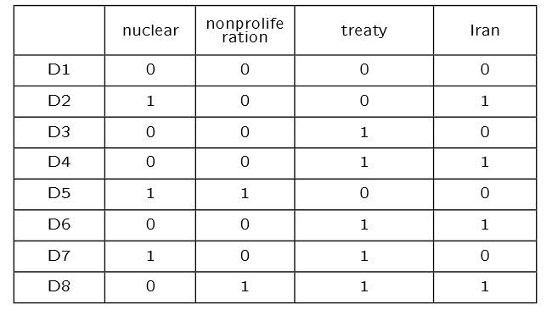
Example:
query :
(nuclear AND treaty) OR ((NOT treaty) AND (nonproliferation OR Iran))
retrieved documents :
D2 = (1 AND 0) OR ((NOT 0) AND (0 OR 1)) = 0 or (1 and 1) = 0 or 1 = 1
D5 = (1 AND 0) OR ((NOT 0) AND (1 OR 0)) = 0 or (1 and 1) = 0 or 1 = 1
D7 = (1 AND 1) OR ((NOT 1) AND (0 OR 0)) = 1 or (0 and 0) = 1 or 0 = 1

Slide 18
Advantages:
simplest model to build an IR system.
Users get transparency: it is easy to understand why a document was retrieved.
Users get control: easy to determine whether the query is too specific (few results) or too broad (many results).

Slide 19
Disadvantages:
Retrieval based on binary decision criteria with no notion of partial matching
No ranking of the documents is provided (absence of a grading scale)

Slide 20
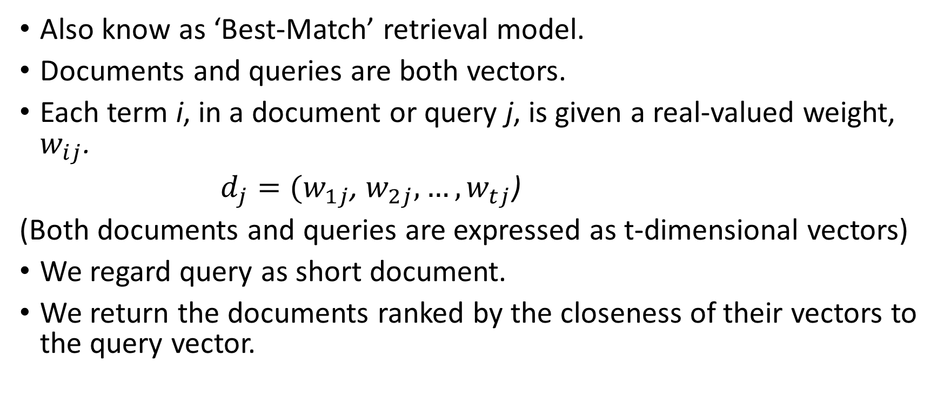
Vector-space retrieval models
Also know as ‘Best-Match’ retrieval model.
Documents and queries are both vectors.
Each term i, in a document or query j, is given a real-valued weight, $w_{ij}$.
$d_{j}=(w_{1j}$,$w_{2j}{, …, w}_{tj}$)
(Both documents and queries are expressed as t-dimensional vectors)
We regard query as short document.
We return the documents ranked by the closeness of their vectors to the query vector.

Slide 21
Advantages:
Ranked retrieval
Terms are weighted by importance.
Partial matches.

Slide 22
Disadvantages:
Assumes terms are independent(Missing semantic information)
Missing syntactic information(e.g. phrase structure, word order)
Weighting is intuitive but not very formal.

